Slide 1
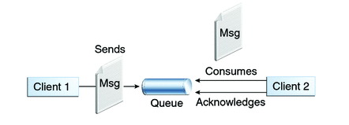

Spring + JMS + RabbitMQ example
We will see the alternative to javax.jms.MessageListener which allows us to create MessageListeners using plain POJO’s, thanks to Spring’s very own @JmsListener, used in combination with JmsListenerConnectionFactory and @EnableJMS. Let’s get started.
Queues [point-to-point]: Queue’s are based on point-to-point messaging model where messages are sent to a queue. Each message has exactly one sender and one receiver. Message is guaranteed to be delivered to only one receiver.
SpringJMSProducer Application
SpringJMSConsumer Application

Slide 2
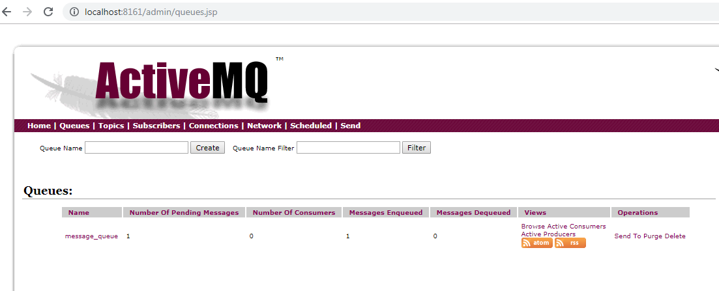
SpringJMSProducer Application

Slide 3
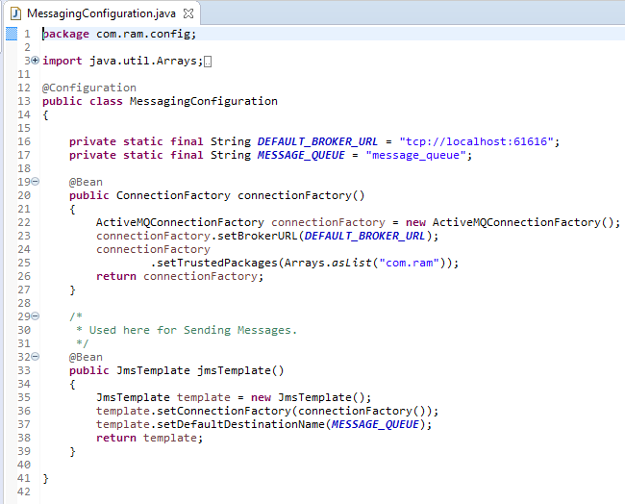
SpringJMSConsumer Application

